Slide 1






Python Project Presentation
By Rajdeep Talukdar

Slide 2



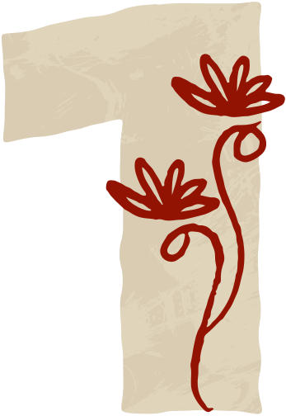
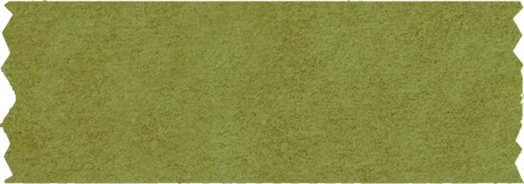
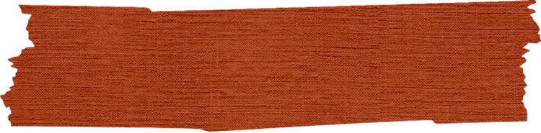
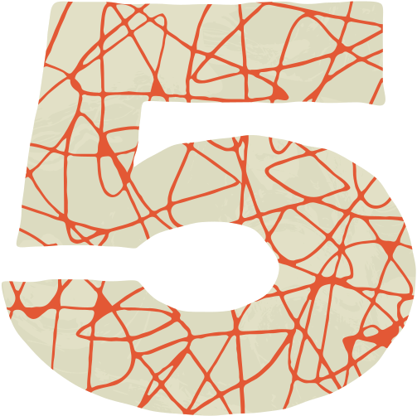
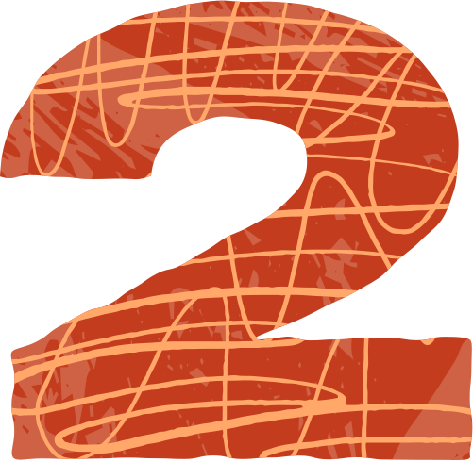
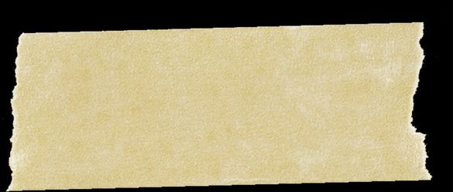
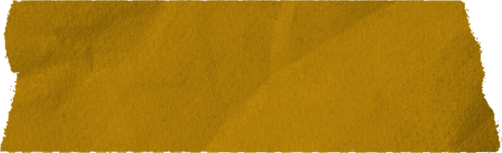



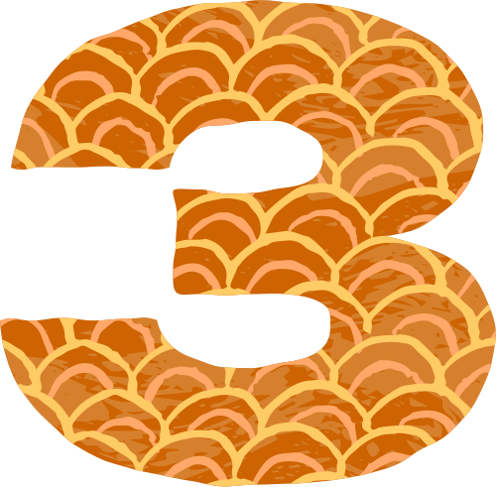
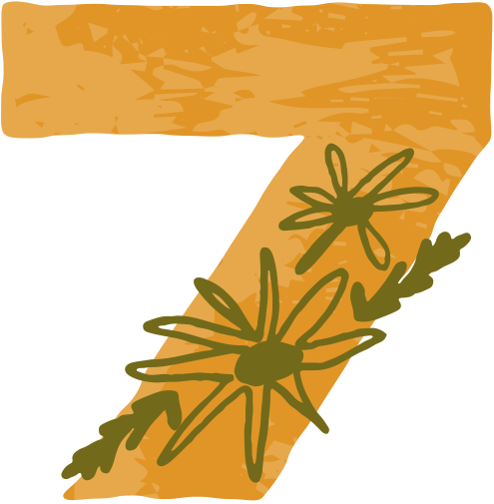
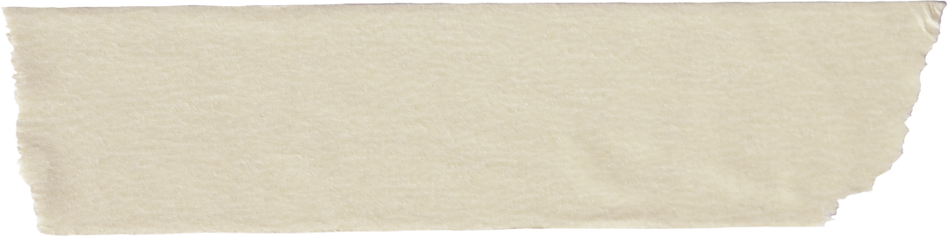

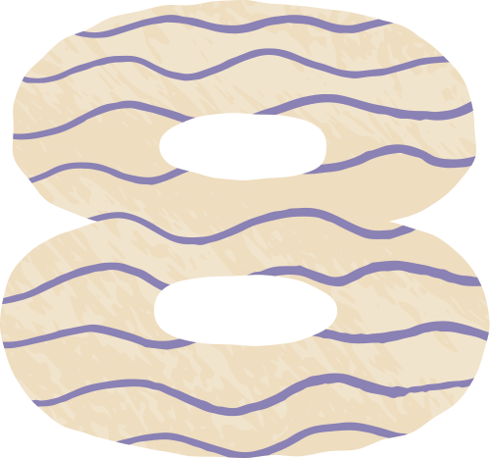
TABLE OF CONTENTS
Introduction
Flowchart
Objectives
Snapshots
Application Tools
Testing & Validation
Project Design
Conclusion

Slide 3
INTRODUCTION
Created a digital chess game using Python and Pygame library.
The game is interactive, user-friendly, and allows two players to play on the same device.
Main goals:
Add chess rules like valid moves, check, and checkmate detection.
To build a simple and appealing design for players.

Slide 4

OBJECTIVES
Build Core Game Mechanics: To add chess rules like valid moves, special moves (castling, en passant), and game states (check, checkmate, stalemate).
Create a User-Friendly Interface: Design an easy-to-use chessboard layout using Pygame for smooth player interaction with mouse clicks.
Develop Seamless Game Flow: Included options to restart, quit, and manage player turns.
Ensure Code Modularity: Write clear and reusable code with organized classes and functions to allow future improvements or new features.

Slide 5
APPLICATION TOOLS
Programming Language: Used Python language for the game logic and interface due to its simplicity, readability, and extensive library support.
IDEs (Integrated Development Environments): PyCharm was used for writing, debugging, and organizing the code effectively.
Libraries: Pygame was the main library used for creating the graphical interface, managing events, and rendering game visuals.
Version Control:
Git: Used for tracking code changes and managing version control.
GitHub: Hosted the project code for remote access and collaboration.
Documentation: Microsoft Word was used for creating and formatting the project report.

Slide 6
PROJECT DESIGN
Game Initialization: The main file sets up the Pygame environment, loads images, and configures the board layout.
Key Classes and Functions:
ChessBoard Class: It manages the chessboard layout, tracks piece positions, and handles the initial setup.
Piece Class: The Piece class is the parent class for all chess pieces, defining common attributes like color, position, and methods like move validation and capturing.
GameManager Class: Oversees game flow, validates moves, keeps track of the current player, updates the game state, and checks conditions like check, checkmate, and stalemate.
User Input Functions: Manage user input and interpret mouse clicks for selecting and moving pieces and interacting with GameManager for validation.
Component Interactions:
The ChessBoard class collaborates with the GameManager to update the visual board with each move.
GameManager relies on each piece's movement rules to validate actions.
User input functions capture mouse clicks and pass selected moves to GameManager for validation and execution.

Slide 7
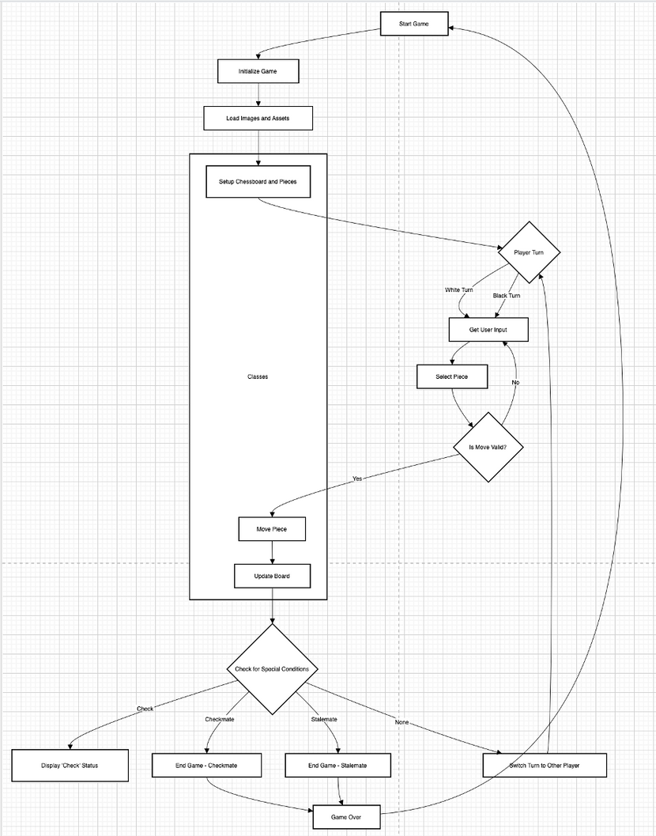
FLOWCHART

Slide 8
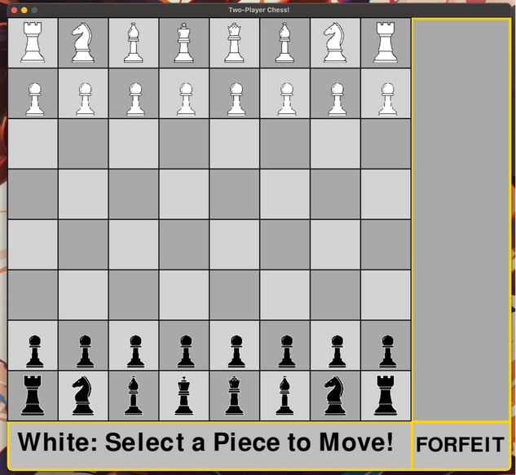
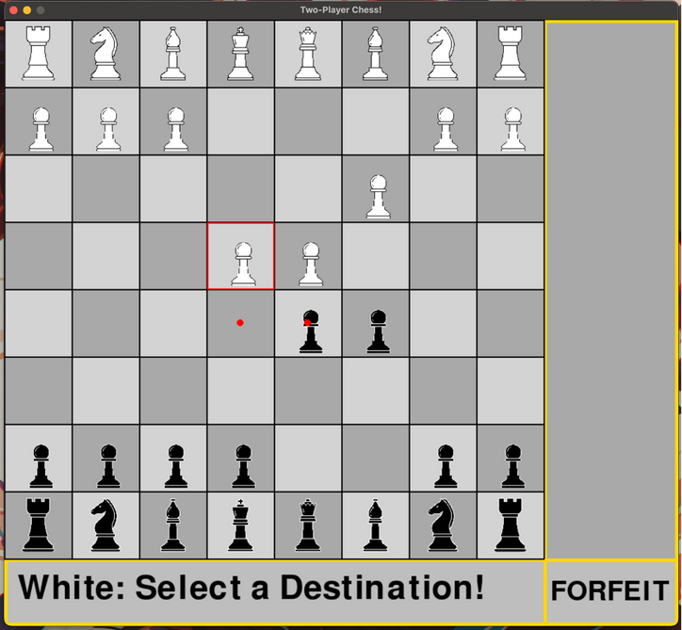
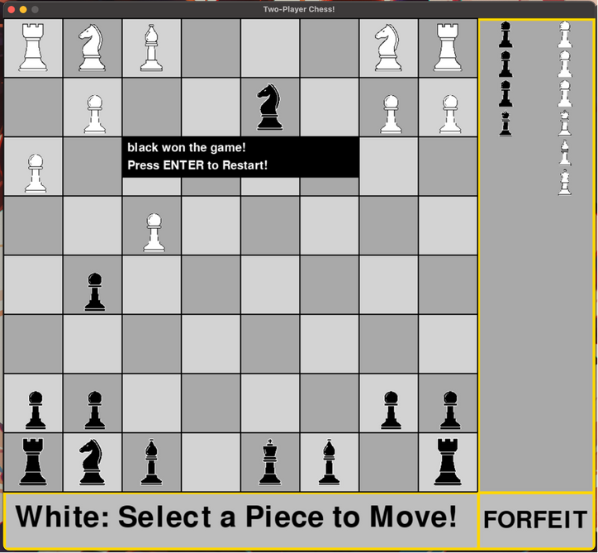
SNAPSHOTS

Slide 9
TESTING & VALIDATION
Unit Testing
Integration Testing
System Testing
Manual Testing
Verifies the functionality of individual components or methods in the game.
Key Areas Tested:
Piece movement validation according to the rules (e.g., pawns moving forward, knights moving in an "L" shape).
Illegal moves (e.g., moving a rook diagonally) are not allowed.
Verifies that the game accurately tracks check, checkmate, and stalemate conditions.
Validates the entire game workflow to ensure it works as intended.
Key Areas Tested:
Ensured that the game initializes correctly, allowing players to start a new game or restart after a match.
Verified that the game correctly detects check and checkmate conditions and displays the appropriate messages.
Ensured the chessboard is visually updated after each move, and user inputs (mouse clicks) are processed correctly.
The game was manually played under various scenarios to identify issues.
Key Areas Tested:
Tested real-time player interactions, including selecting and moving pieces and how the game handles legal and illegal moves.
Ensured that the game enforces chess rules, such as no piece moving through other pieces (except for knights).
Checks how different components of the game work together.
Key Areas Tested:
Piece interaction ensures that pieces can interact with each other correctly (e.g., a pawn capturing an opponent’s piece).
Verified that the game alternates turns between the two players and prevents actions outside the player's turn.
Tested the flow of the game from start to finish, including move history and updating the board after each move.

Slide 10
CONCLUSION
This project successfully created a digital chess game using Python and Pygame. It implemented key chess rules like move validation, check, checkmate, and turn management, along with a simple and engaging interface.
The main achievement was building a solid game logic that handles various chess scenarios. The project also helped apply Python concepts and use Pygame for graphics and user interaction.
However, the game has limitations, such as no AI opponent or move undo feature. Future improvements could add these and enhance performance and visuals.
Overall, this project is a fun game and a valuable learning experience in using Python for game development.

Slide 11
Thank You

